Slide 1

Grammar Focus: passive (2) in Present continuous, Present perfect, Modal

Slide 2
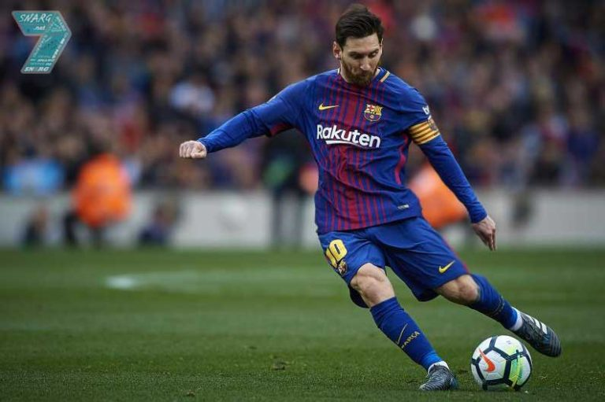
A. Passive voice is used when we only focus on the event not the subject who does it
Active : Messi is kicking the ball.
Passive : The ball is being kicked by Messi.

Slide 3
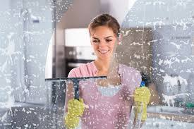
B. Passive voice is used to avoid the subject
Active : Lisa cleans the glass.
Passive : The glass is cleaned.

Slide 4
Passive in Present continuous, Present perfect, Modal
Passive form in Present Continuous : S + is/am/are + being + V3
Passive form in Present Perfect : S + have/has + been + V3
Passive form using Modal : S + modal + be + V3
Example:
Tense | Active | Passive
Present Continuous | John is helping Mary | Mary is being helped by John
Present Perfect | John has helped Mary | Mary has been helped by John
Modals | John can help Mary | Mary can be helped by John

Slide 5
Activity 1 - Make passive sentences using Present continuous, Present perfect or Modal based on the words given
Example: That house, paint, he, right now
That house is being painted by him right now.
1. The book, publish, the publisher, next month
______________________________________
2. The letters, send, just now, Edward
______________________________________
3. My documents, sign, just, Mr. Smith
______________________________________
4. A big box, can, lift, my uncle
______________________________________
5. Prizes, award, right now, committee
______________________________________
6. Customers, serve, waiters, right now
______________________________________
7. Three parks, build, the government, recently
______________________________________
8. A cup of coffee, drink, Alex, at the moment
______________________________________
9. The machines, fix, now, technician
______________________________________
10. The big tree, must, cut down, soon, officer
_____________________________________

Slide 6
Activity 2 – Complete the dialogue below with the correct form of passive. Then Practice the the dialogue with your friends
Ray : Daddy, where is my bicycle? Have you seen it?
Dad : The bicycle (repair) ____________________ by the mechanic right now.
Ray : Since when? I didn’t know about that.
Dad : It has been two days.
Ray : When (it, will, fix) ____________________?
Dad : Your bicycle (do) ____________________ tomorrow Ray. I will take you to the school.
Ray : Thanks Dad. I will get my breakfast first.
Ray : (In the kitchen) Hi Mom, good morning.
Mom : Good morning Ray.
Ray : Where is my meal Mom?
Mom : It’s on the table, dear.
Ray : who has just made the meal, Mom? Because the smell is really delicious.
Mom : The meal (just make) ____________________ by your dad, dear.
Ray : Really? It tastes so great.

